Slide 1

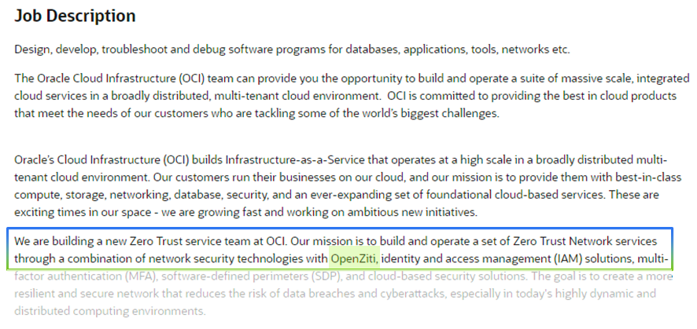
Oracle Cloud builds their ZTNA on Ziti
Oracle Building New Zero Trust Service on Ziti
"...our Mission is to build and operate a set of Zero Trust Network services through a combination of network security technologies with OpenZiti…”
NetFoundry Inc. © Copyright 2023

Slide 2
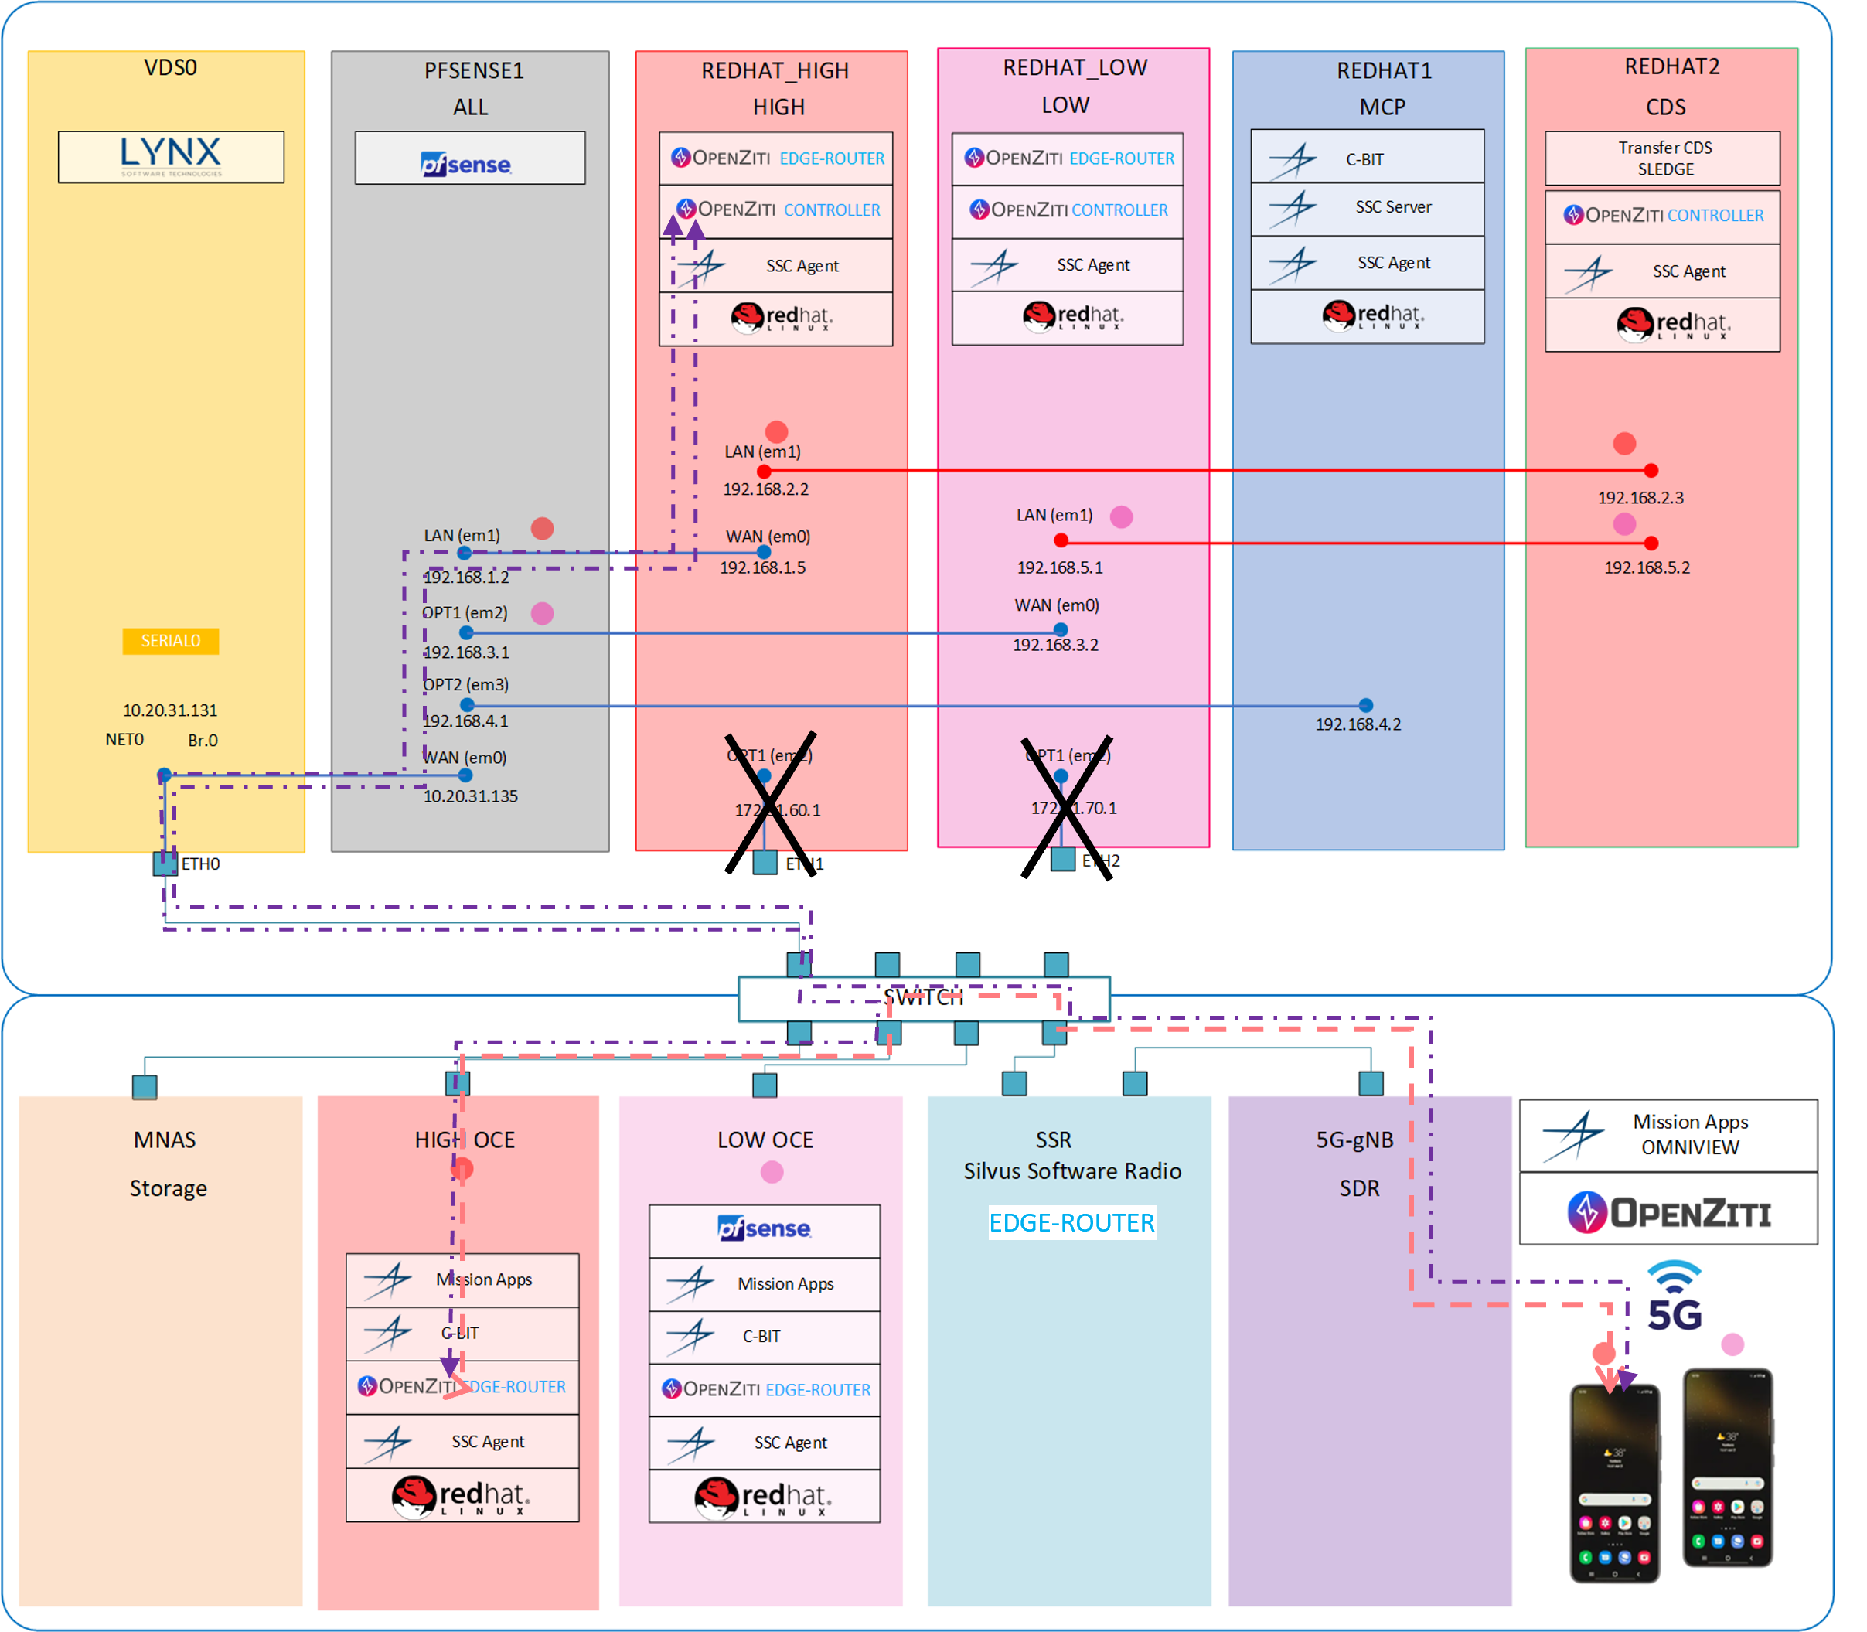
Military contractor builds zero trust mobile comms on Ziti (confidential)
NetFoundry Inc. © Copyright 2023

Slide 3
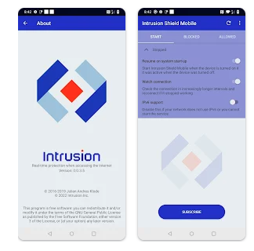

Intrusion builds their zero trust solution on Ziti
"The newly released Federal Cybersecurity Strategy makes it clear that the technology industry must begin to take more responsibility for protecting the public from cybercriminals. Intrusion is proud to partner with NetFoundry to help accelerate this transformation."
Tony Scott, CEO Intrusion, US Federal CIO 2015-2017
“To build the secure and resilient future we want, we must shape market forces to place responsibility on those within our digital ecosystem that are best positioned to reduce risk"
NetFoundry Inc. © Copyright 2023

Slide 4
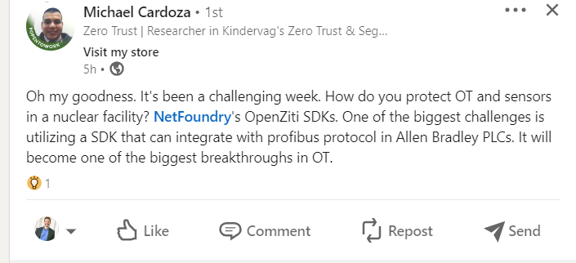

Slide 5
Investment update (same as June 2022, September 2022, Feb/March 2023)
Raise VC when ARR is 2x-3x YoY and/or usage is at 3x-5x YoY
Raise $10M+ annual from Tata in the meantime
Move now?
  We are almost at 2x ARR
  Prioritized customer usage is above targets
  The market has never been more ready
  Ziti usage is under targets and Ziti 1.0, browZer, zrok evolution and taste of Ziti could change that in a hurry
  Prioritized customer usage is above targets
  Market *may be* more ready in future
Current state: close a VC or strategic-led round if we can get the right partner with the right valuation. A $100M - $200M valuation is achievable when we get exponential Ziti adoption of operators and developers in our ICP, using us for our UVP.
NetFoundry Inc. © Copyright 2023

Slide 6










Internetworking UVP
Security & control
Managing distributed resources,
with speed, efficiency & quality
NetFoundry Inc. © Copyright 2023

Slide 7
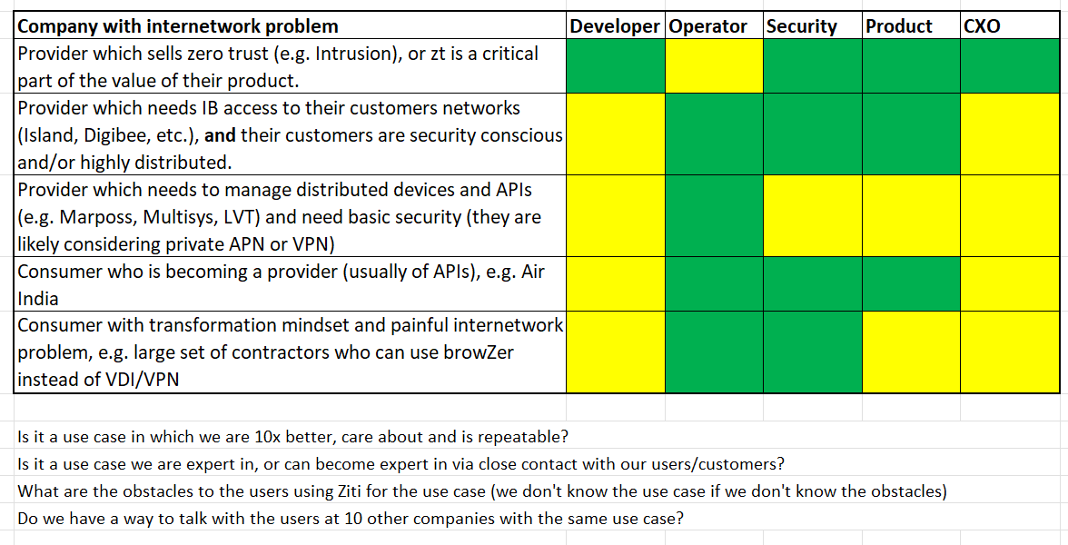
Internetworking ICP
NetFoundry Inc. © Copyright 2023

Slide 8
3 choices
Ignore
Iterate
Innovate
NetFoundry Inc. © Copyright 2023

Slide 9
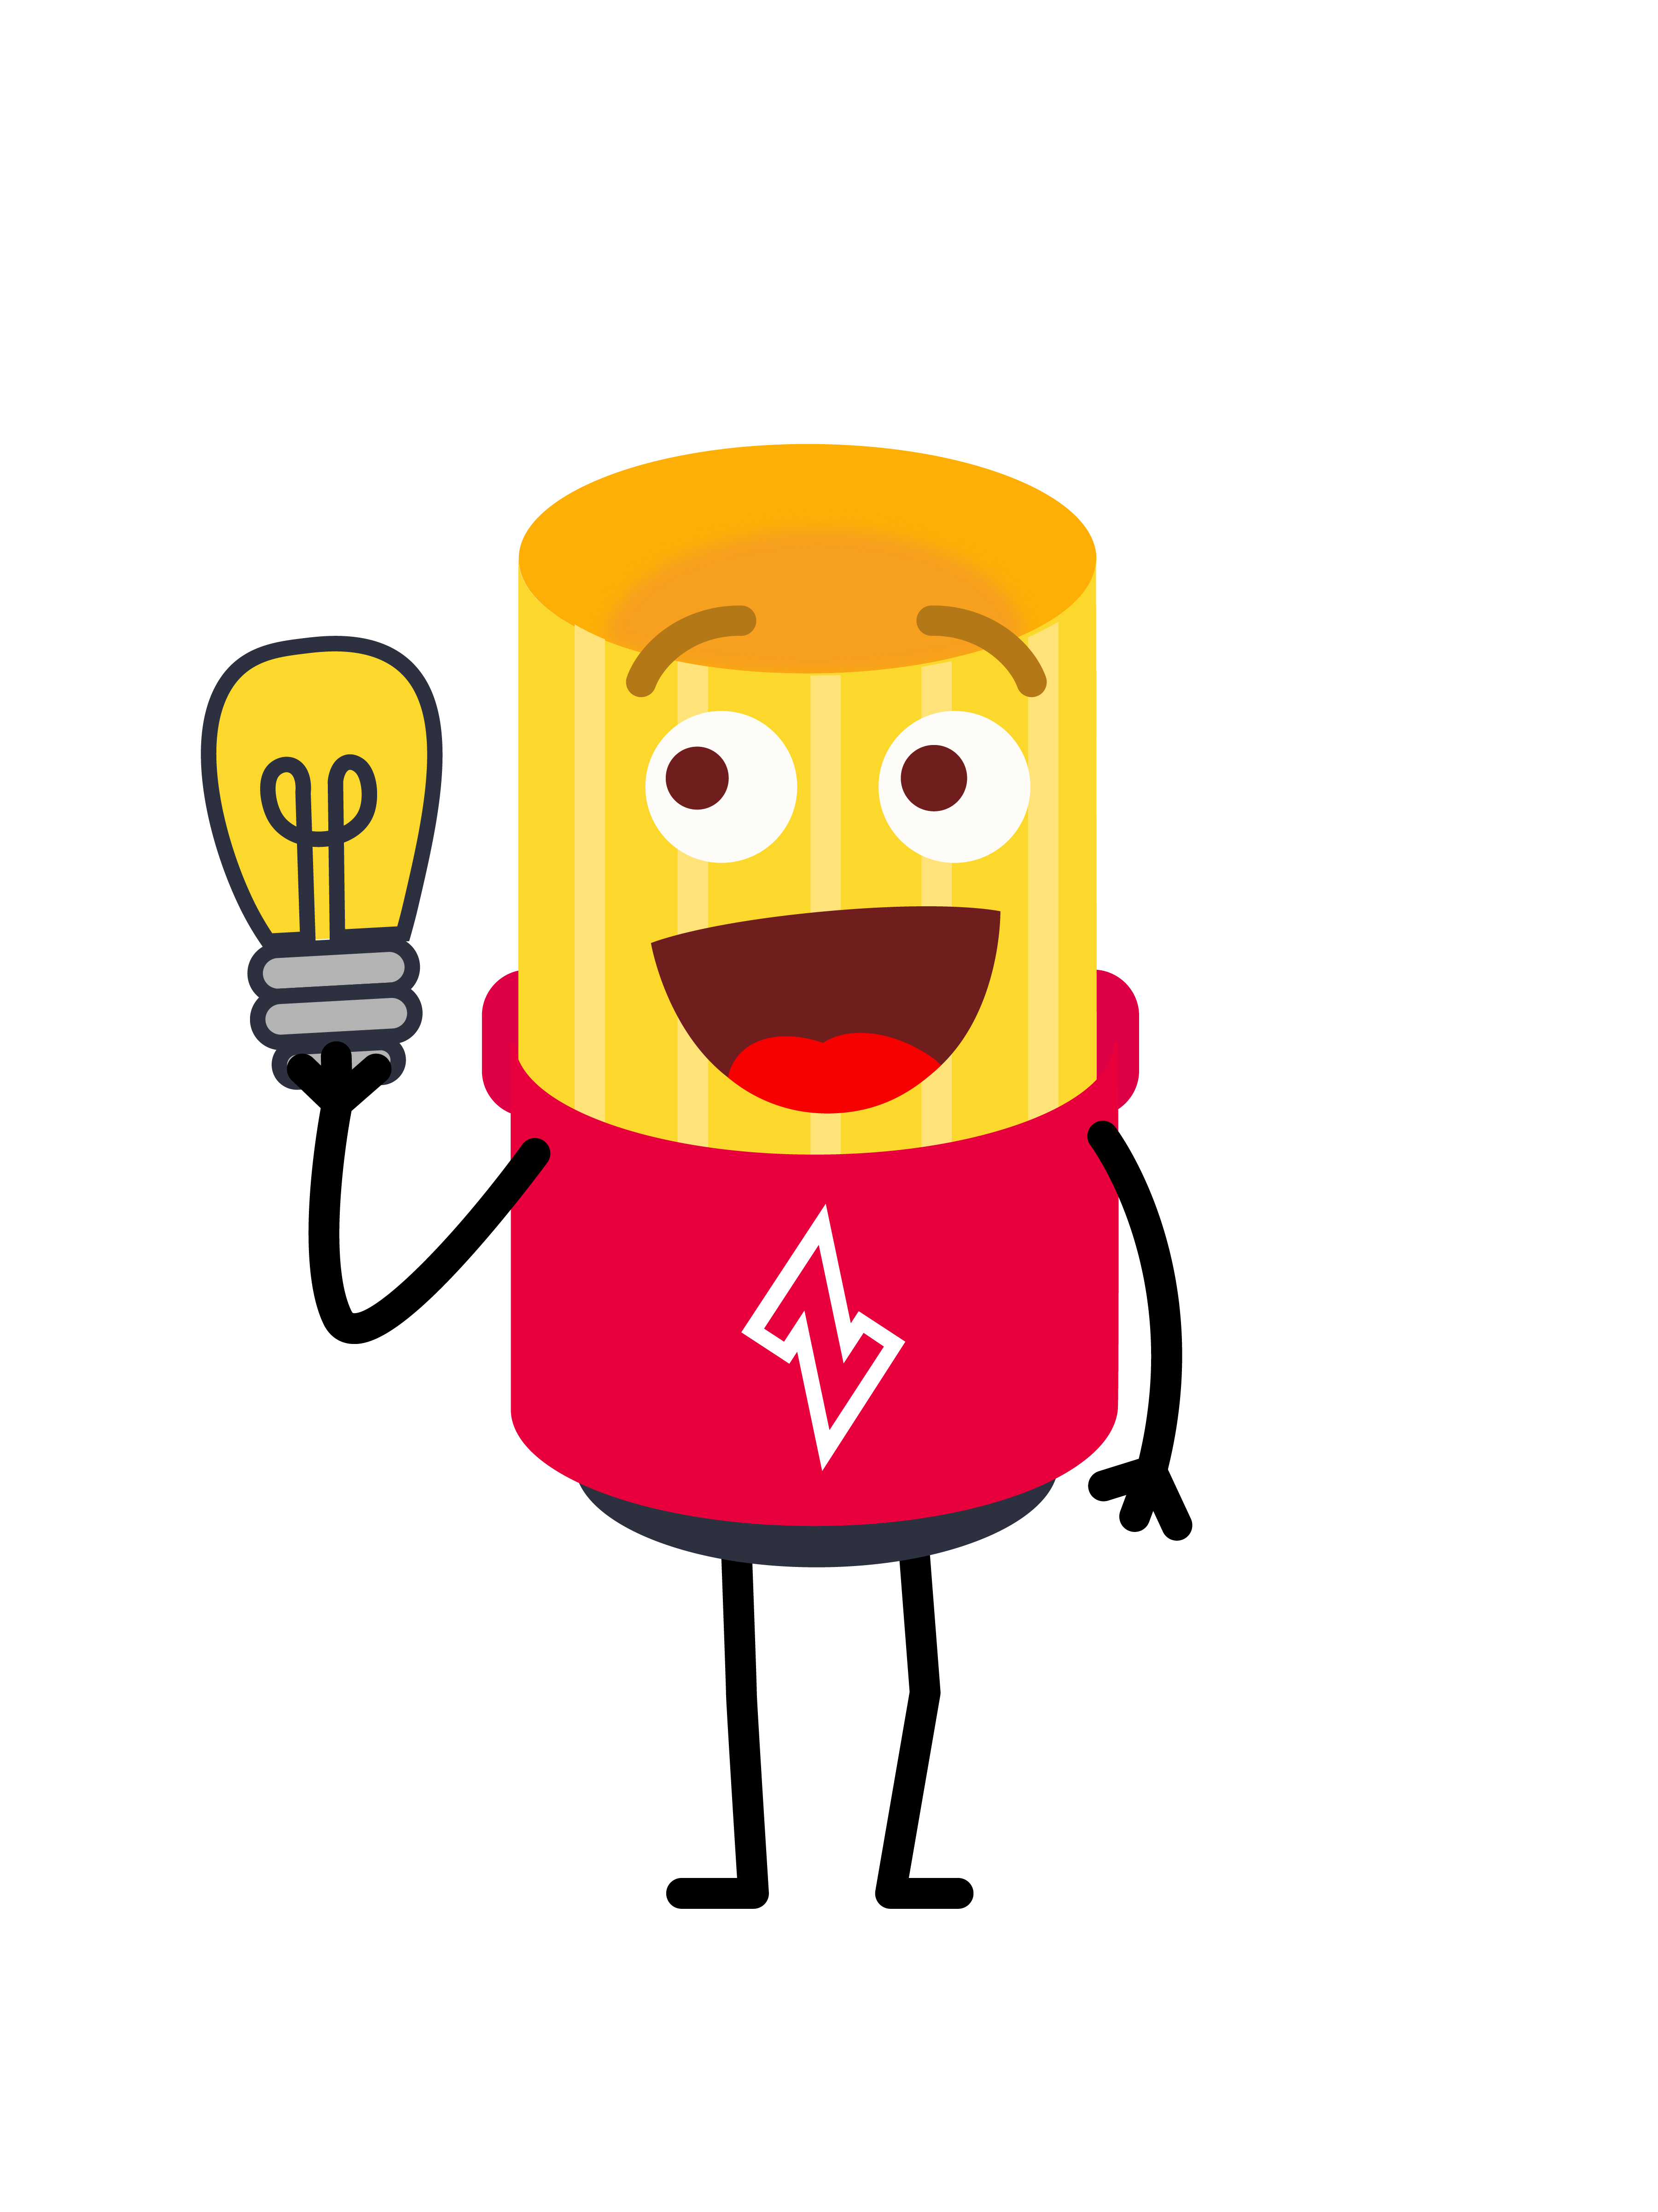
Actions are culture
Innovate. Innovate to help make the dynamic, audacious path to reinvent secure networking. Strong convictions, weakly held. Disagree but commit.
Learn and empathize. Learn from users and empathize with their real-world pain points and contexts. Meet users where they are.
Work hard with focus and alignment. Meeting aggressive goals via hard, focused, aligned work is necessary for a startup to beat the world. Required for velocity.
Old all hand slides above. The update to it:
Nothing is more important than understanding the challenges our ICP users and stakeholders face for internetworking, and the 'why' behind those challenges, and then working with them on solutions for those problems. We have not learned, empathized, met users where they are (enough).
NetFoundry Inc. © Copyright 2023

Slide 10

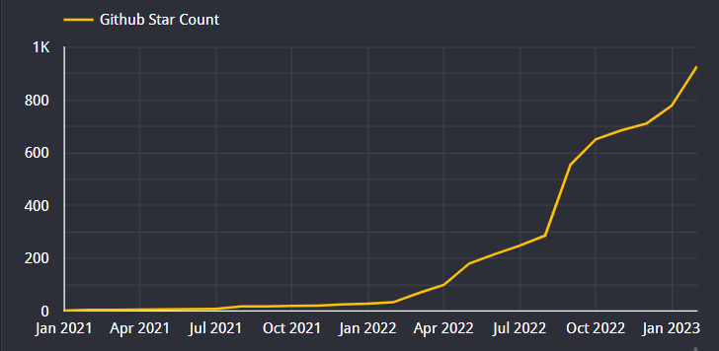
Cover the earth a foot deep in Ziti - OpenZiti
Make Ziti more delicious and easier to use for specific use cases
Get Ziti in the hands of builders and operators (zrok, browzer, openziti 1.0).
Engage, learn, empathize.
Meet users where they are. Solution recipes. Docs.
Old all hand slides above. The update to it:
Zrok very successful. BrowZer and OZ 1.0 delayed. Solution recipes are regularly appreciated by users but we don't have enough of them, and they can be difficult to find.
NetFoundry Inc. © Copyright 2023

Slide 11
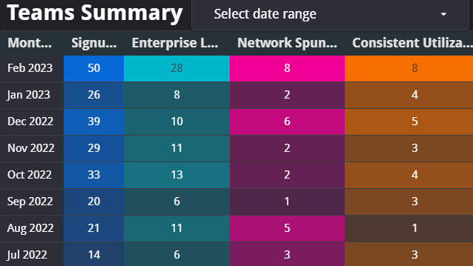
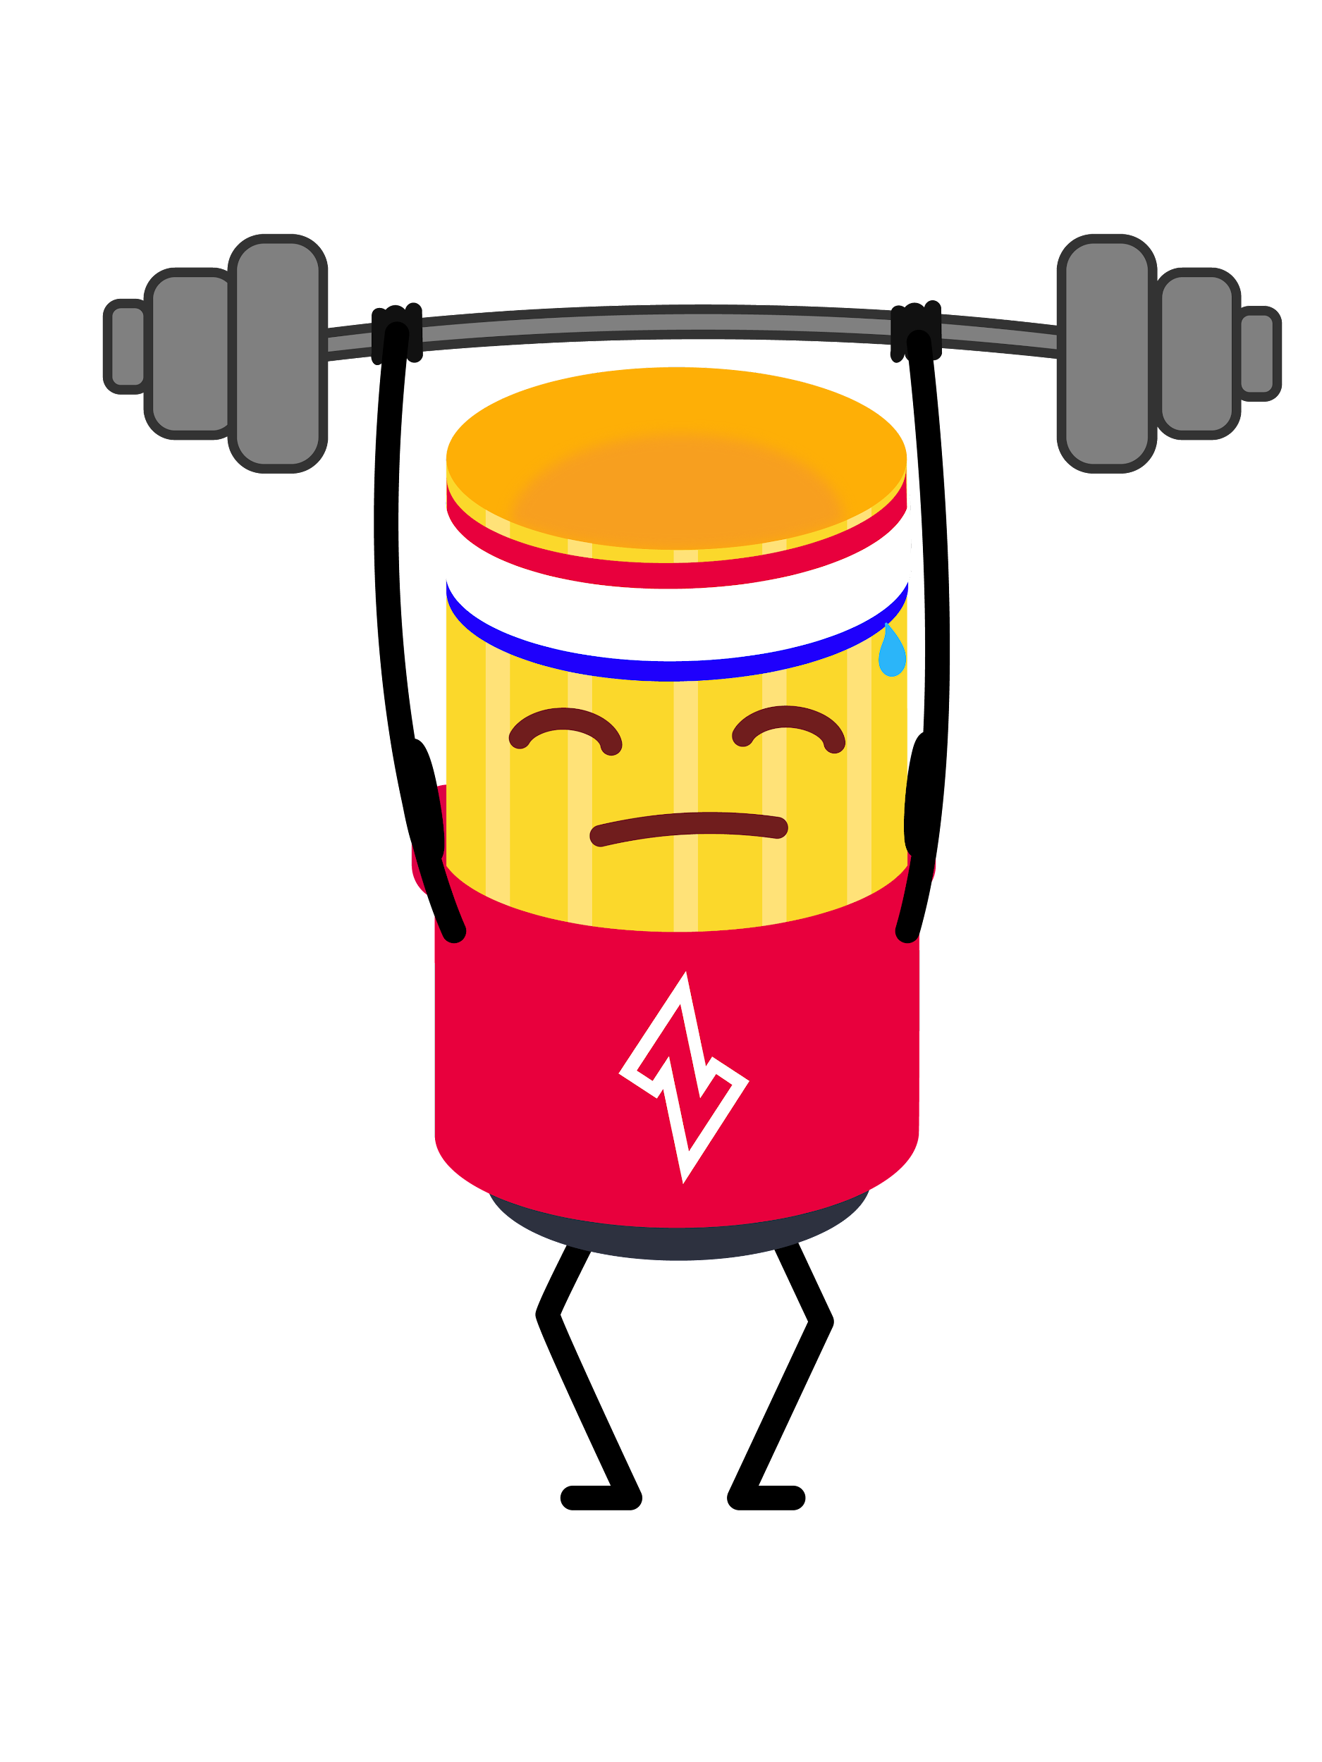
Cover the earth a foot deep in Ziti - Teams
Enable hands-on, no-sales personas to taste Ziti...and like it
Reliability and UX
Old all hand slides above. The update to it:
Teams didn't work. The user abandons before they realize how to use it, or how Ziti can easily solve the specific problem they have in mind. Rebuilding as Taste of Ziti as a way to improve both Teams and OZ entry (which is also too complex for most users, at least those who try it).
NetFoundry Inc. © Copyright 2023

Slide 12
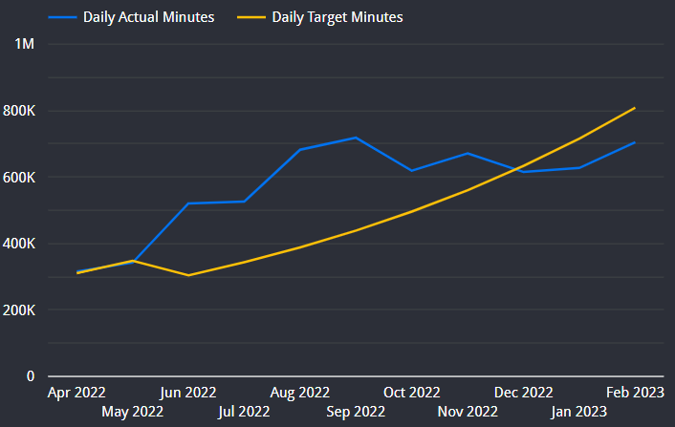
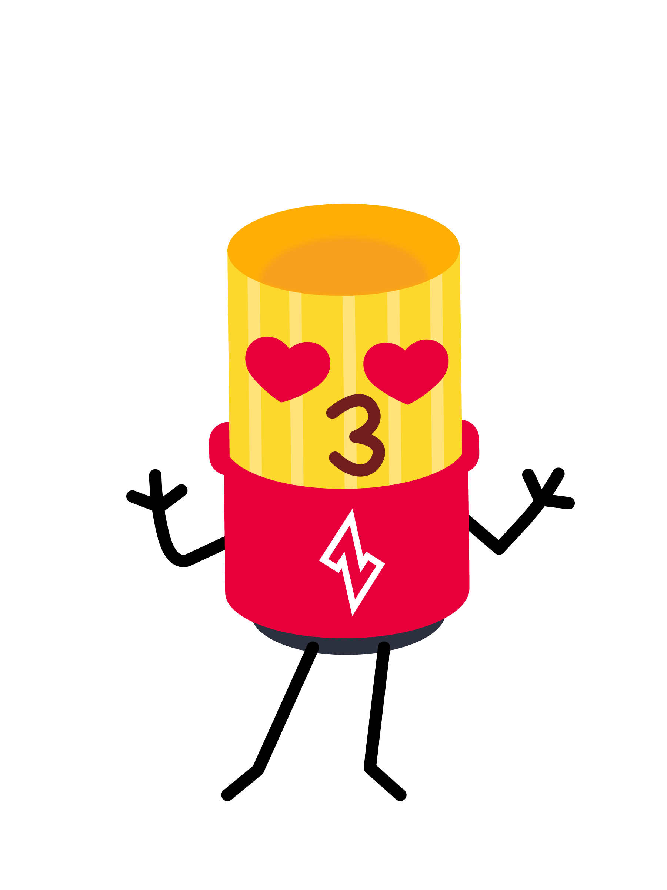
Cover the earth a foot deep in Ziti - CloudZiti
Serve lighthouse customers with excellence
Quality. UX. Solution recipes.
Engage, learn, empathize. World class ops and customer success.
Operate efficiently.
Old all hand slides above. The update to it:
Fantastic work.
NetFoundry Inc. © Copyright 2023

Slide 13
Adding $6M of ARR (start of year plan)
Land and expand. Grow existing customers by $1M ARR. Includes existing Teams and Growth accounts.
PLG pipeline conversion. $1.5M ARR from user-started product use (OpenZiti and CloudZiti Teams).
Existing CloudZiti funnel conversion. $1.5M ARR from funnel ($3M).
New CloudZiti funnel creation and conversion. $1.5M ARR with at least 50% from topx outbound.
Lighthouse customer wins from customers already using Ziti. Yahoo, IBM, Digibee, Lockheed, Critical infrastructure (Duke, PNNL, SEL, GDIT, National Grid, Claroty), Lockheed, US Air Force, Oracle Cloud, Deloitte, Deutsche Telecom, EdgeX, Caja Rural, Dapr, Fannie Mae, Tempest, etc.
Old all hand slides above. The update to it:
The green has worked; the red has not worked; the yellow has worked to some degree.
NetFoundry Inc. © Copyright 2021

